Slide 1

CE101 Engineering Drawing Lec2: Conics and Curves
Indian Institute of Technology Guwahati

Slide 2
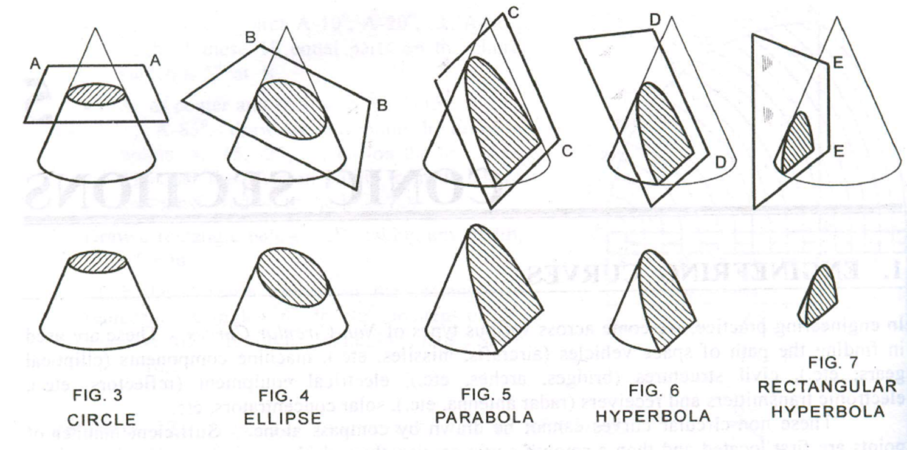
Conic Sections
Sections of a right circular cone obtained by cutting in different ways
Depending on the position of the cutting plane relative to the axis of cone, three conic sections can be obtained
Ellipse
Parabola
Hyperbola

Slide 3
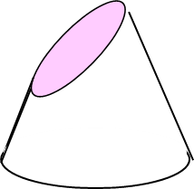
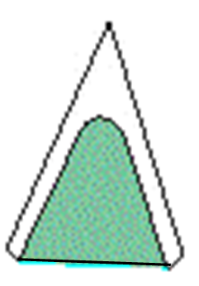
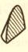
Conic Sections
O
A
B
An ellipse is obtained when a section plane A–A, inclined to the axis cuts all the generators of the cone.
A parabola is obtained when a section plane B–B, parallel to one of the generators cuts the cone. The section plane will definitely cut the base of the cone.
A hyperbola is obtained when a section plane C–C, inclined to the axis cuts the cone on one side of the axis.
A rectangular hyperbola is obtained when a section plane D–D, parallel to the axis cuts the cone.
C
A
D
O
B
C
D

Slide 4
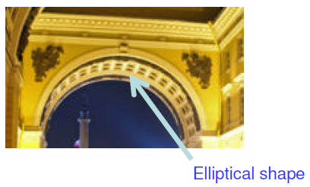
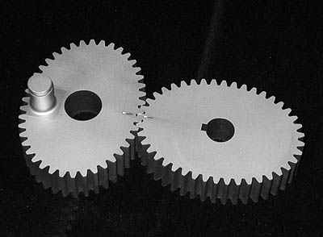
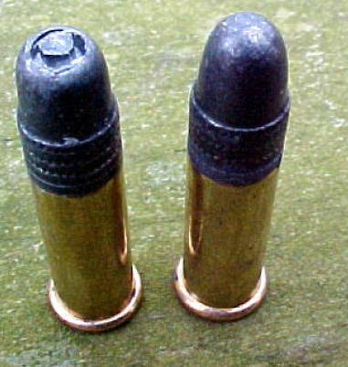
Few Applications of Ellipse
Elliptical Arch
Elliptical gear
Bullet nose

Slide 5
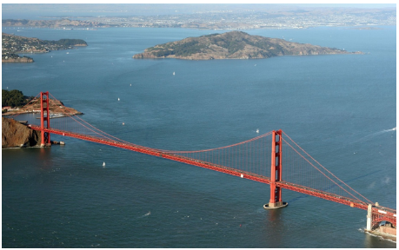
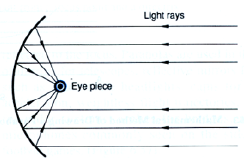
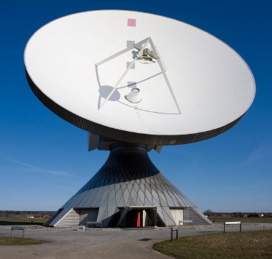
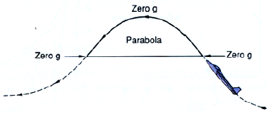
Few Applications of Parabola
Telescopic Mirror
Suspension cables
Radio telescopes
Weightless flight trajectory

Slide 6
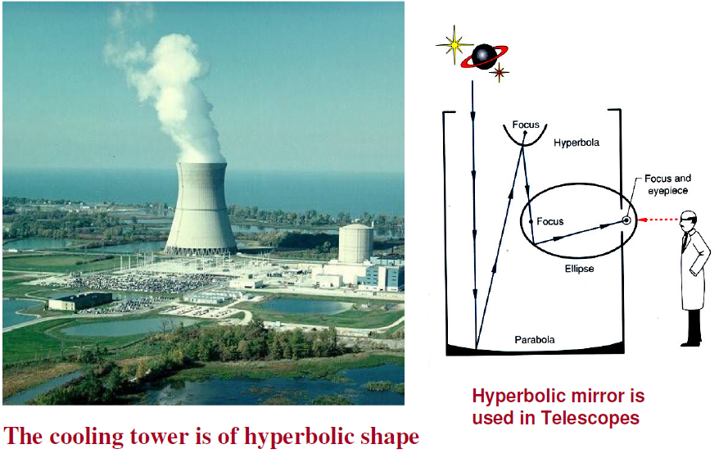
Few Applications of Hyperbola

Slide 7
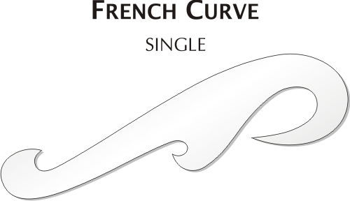
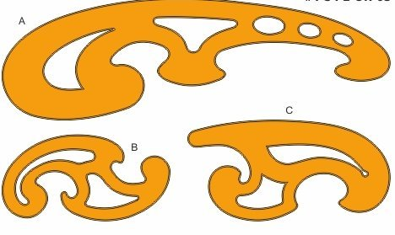
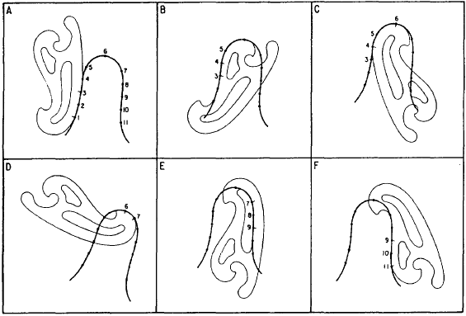
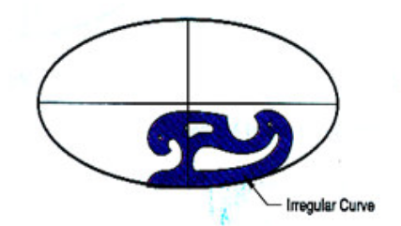
French Curves

Slide 8
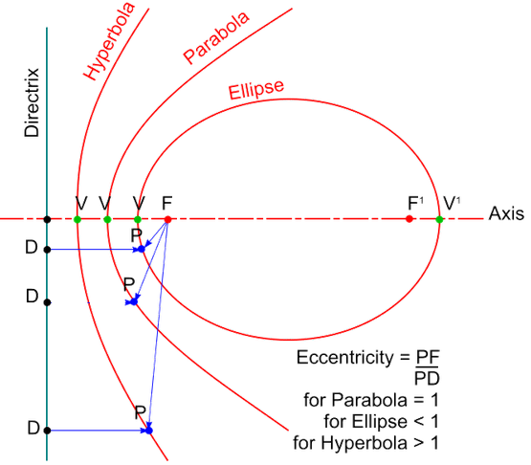
Basic Characteristics of Conics
Conic is defined as the locus of a point moving in a plane such that the ratio of its distance from a fixed point (Focus, F) to the fixed straight line (Directrix) is always a constant.
The ratio is called eccentricity (e)
Eccentricity (e) | Conic
<1 | Ellipse
1 | Parabola
>1 | Hyperbola

Slide 9
ELLIPSE
Notes:
Today we will discuss about the Modeling and

Slide 10
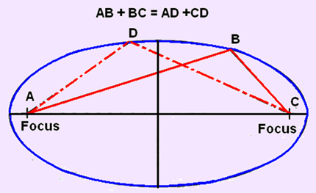
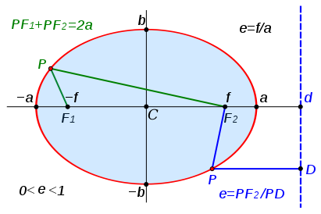
Ellipse
A curved line forming a closed loop
Sum of the distances from two points (foci) to every point on the line is constant (PF₁+PF₂) = Length of its major axis (2a)
The distance of any end of the minor axis from any focus is equal to the half of the major axis (F₁b, F₂b)
If the major (-a,a) and minor axes (-b,b) are provided, then the foci (F₁, F₂) can be located by cutting the arcs on major axis with (b or –b) as a center and radius = ½ major axis = a
a

Slide 11
Methods for Generating Ellipse
Focus-Directrix / Eccentricity Method
General method of constructing any conic when the distance of the focus from the directrix and its eccentricity is given
Concentric Circle Method
This method is applicable when the major axis and minor axis of an ellipse are given
Arc of Circle Method
This method is applicable when the major axis and minor axis of an ellipse are given
Oblong Method (Rectangle / Parallelogram)
This method is applicable when the major axis and minor axis with the angle between them is given

Slide 12
Methods for Generating Ellipse
Focus-Directrix / Eccentricity Method
Draw an ellipse if the distance of the focus from the directrix is 70 mm and the eccentricity is 3/4
Concentric Circle Method
Draw an ellipse having the major axis of 60 mm and the minor axis of 40 mm
Arc of Circle Method
Draw an ellipse having the major axis of 60 mm and the minor axis of 40 mm
Oblong Method (Rectangle / Parallelogram)
Draw an ellipse having conjugate axes of 60 mm and 40 mm long and inclined at 75⁰ to each other

Slide 13
Focus-Directrix / Eccentricity Method
Draw an ellipse if the distance of focus from the directrix is 70 mm and the eccentricity is 3/4
Draw the directrix and axis
Mark F on axis such that CF = 70 mm
Divide CF into 3 + 4 = 7 equal parts and mark V at the fourth division from C.
Now, e = FV/ CV = ¾
At V, erect a perpendicular VB = VF. Join CB
Through F, draw a line at 45° to meet CB produced at D.
Through D, drop a perpendicular DV' on CC'. Mark O at the midpoint of V– V'.
C
V
F
O
V'
C'
B
D

Slide 14
Focus-Directrix / Eccentricity Method
Draw an ellipse if the distance of focus from the directrix is 70 mm and the eccentricity is 3/4
Mark a few points, 1, 2, 3, … on V-V' and erect perpendiculars through them meeting CD at 1', 2', 3'….
Also erect a perpendicular through O
With F as a centre and radius = 1-1', cut two arcs on the perpendicular through 1 to locate P1 and P1’.
Similarly, with F as a centre and radii = 2–2', 3–3' etc., cut arcs on the corresponding perpendiculars to locate P2 and P2', P3 and P3', etc.
Also, cut similar arcs on the perpendicular through O to locate V1 and V1'.
P2
P3
V1
P1
F
2
C
V
1
3
O
V'
C'
P1'
P2'
B
1'
P3'
V1'
2'
3'
O'
D

Slide 15
Focus-Directrix / Eccentricity Method
Draw an ellipse if the distance of focus from the directrix is 70 mm and the eccentricity is 3/4
Similarly, construct for the other half of the major axis O-V'
Use F' for the other half
Join all the marked points to complete the ellipse
P2
P3
V1
P1
F
2
C
V
1
3
O
F'
V'
C'
P1'
P2'
B
1'
F'
P3'
V1'
2'
3'
O'
D

Slide 16
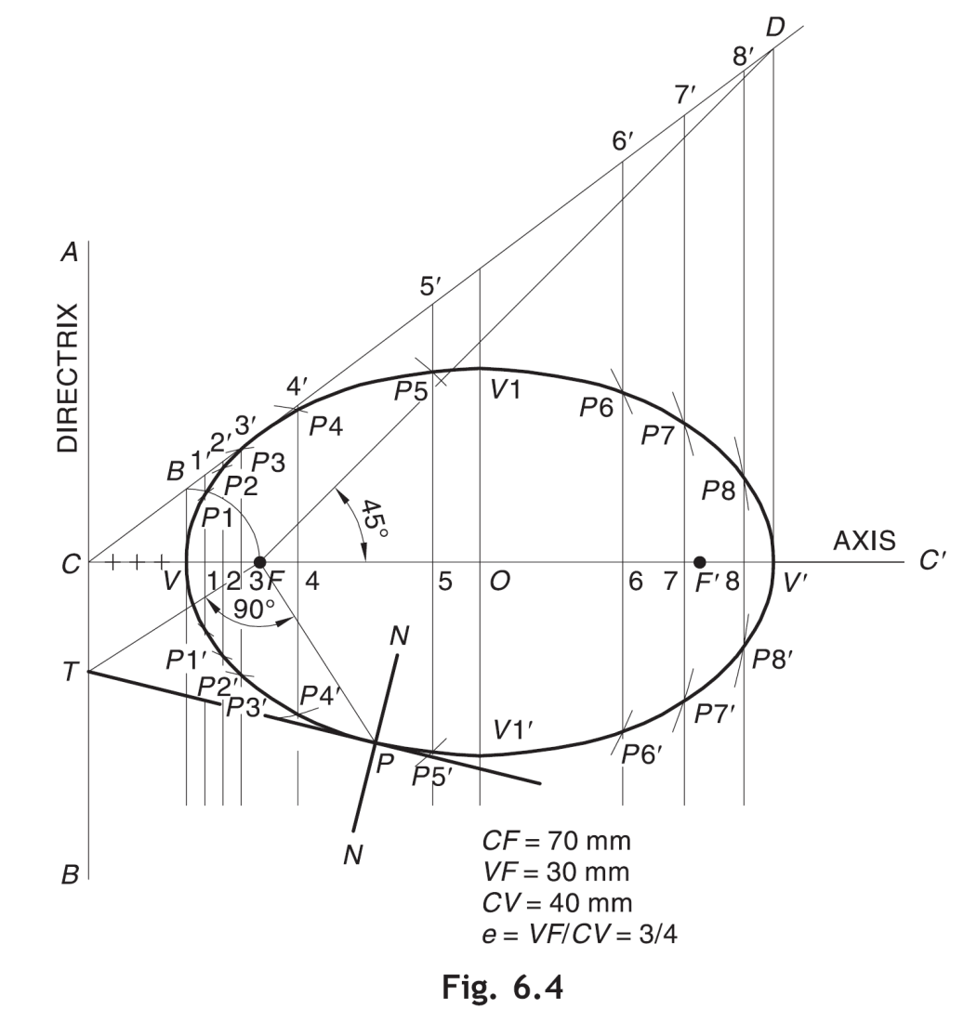
Focus-Directrix / Eccentricity Method
Draw an ellipse if the distance of focus from the directrix is 70 mm and the eccentricity is 3/4

Slide 17
Concentric Circle Method
Draw an ellipse having the major axis of 70 mm and the minor axis of 40 mm
Draw both axes as perpendicular bisectors of each other & name their ends as shown.
Taking their intersecting point as a center, draw two concentric circles considering both as respective diameters.
Divide both circles in 12 equal parts & name as shown.
From all points of outer circle draw vertical lines downwards and upwards respectively.
From all points of inner circle draw horizontal lines to intersect those vertical lines.
Mark all intersecting points properly as those are the points on ellipse.
Join all these points along with the ends of both axes in smooth possible curve. It is required ellipse.
3
2
4
C
1
3
5
2
4
1
5
A
B
O
10
6
10
9
7
6
8
D
9
7
8

Slide 18
Oblong Rectangle Method
Draw an ellipse having the major axis of 70 mm and the minor axis of 45 mm
Draw the major axis AB = 70 mm and minor axis CD = 45 mm, bisecting each other at right angles at O.
Draw a rectangle EFGH such that EF = AB and FG = CD.
Divide AO and AE into same number of equal parts, say 4. Number the divisions as 1, 2, 3 and 1', 2', 3', starting from A.
Join C with 1, 2 and 3.
Join D with 1' and extend it to meet C–1 at P1. Similarly, join D with 2' and 3' and extend them to meet C–2 and C–3 respectively to locate P2 and P3.
Locate the other points by mirror imaging
Join all the marked points to form ellipse
E
C
F
P3
P4
3
P2
P5
2
1
P1
P6
A
P7
B
45
1'
2'
3'
O
P12
P11
P10
P9
P8
H
D
G
70

Slide 19
Oblong Rectangle Method
C
P₃
3
P₂
2
P₁
1
A
1’
2’
3’
O
B
D

Slide 20
Oblong Parallelogram Method
Draw a parallelogram of 100 mm and 70 mm long sides with included angle of 75º. Inscribe an ellipse.
STEPS ARE SIMILAR TO THE PREVIOUS CASE (RECTANGLE METHOD)
IN PLACE OF RECTANGLE,
A PARALLELOGRAM IS DRAWN.
Used when the conjugate axes with the angle
between them is given.
4
4
3
3
2
2
1
1
A
1
3
4
3
2
1
B
2

Slide 21
Arcs of Circle Method
Major axis AB and minor axis CD are 100 mm & 70 mm long, respectively. Draw the ellipse by arcs of circles method.
Draw both axes as usual. Name the ends and intersecting point.
Taking AO distance, i.e. half of the major axis, from C, mark foci F1 & F2 on AB.
On line F1-O, taking any distance, mark points 1, 2, 3 and 4
Taking F1 as center, with distance A-1, draw an arc above AB
Taking F2 as center, with B-1 distance, cut this arc.
Intersection points of the two arcs are points on the ellipse. Name the point p1.
Repeat this step with same center (F1) but with A-2 and B-2 distances for drawing arcs. Name the point p2.
Similarly, get all other P points by repeating the above steps
Following the same steps, positions of P below AB can be located as well
Join all points by smooth curve to get an ellipse. (use a French curve).

Slide 22
Arcs of Circle Method
Major axis AB and minor axis CD are 100 mm & 70 mm long, respectively. Draw the ellipse by arcs of circles method.
p₄
C
p₃
p₂
p₁
A
O
B
F₁
1 2 3 4
F₂
D

Slide 23
Tangent and Normal to Ellipse
D
Tangent and Normal at any point P on the ellipse using Directrix
Mark the given point P and join PF₁
At F₁ draw a line perpendicular to PF₁ to cut DD at Q.
Join QP and extend it. QP is the tangent at P.
Through P, draw a line NM perpendicular to QP. NM is the normal at P.
N
P
Q
C
M
O
F₂
V'
V
F₁
C'
D

Slide 24
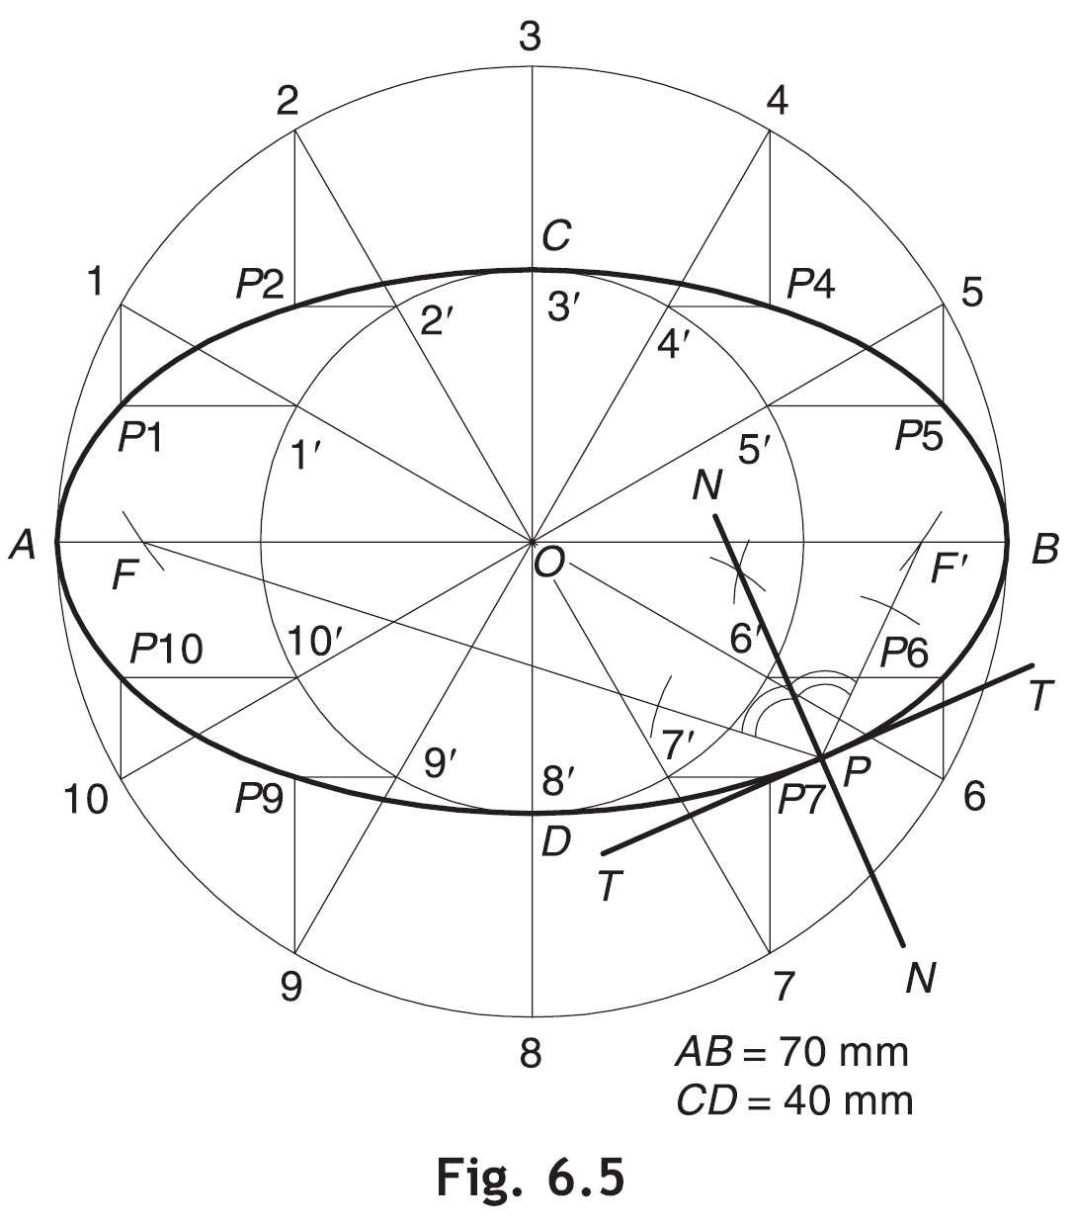
Tangent and Normal to Ellipse
Tangent and Normal at any point P when Focus and Directrix are not known
First obtain the foci F and F′ by cutting the arcs on major axis with C as a centre and radius = OA
Join PF and PF'
Obtain NN, the bisector of ∠FPF′. N-N is the required normal
Draw TT perpendicular to N-N at P. T-T is the required tangent.

Slide 25
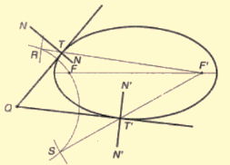
Tangent and Normal to Ellipse
Tangent and Normal from a point outside ellipse
With Q as center and radius = QF, draw arc
With F' as center and radius = (major axis), draw arc to cut previous at R and S
Join RF' & SF', cutting ellipse at T & T' respectively.
Join QT & QT' to represent the required tangent. Draw N-N & N'-N', perpendicular to QT & QT' at T & T' respectively for normal.

Slide 26
Parabola
Notes:
Today we will discuss about the Modeling and

Slide 27
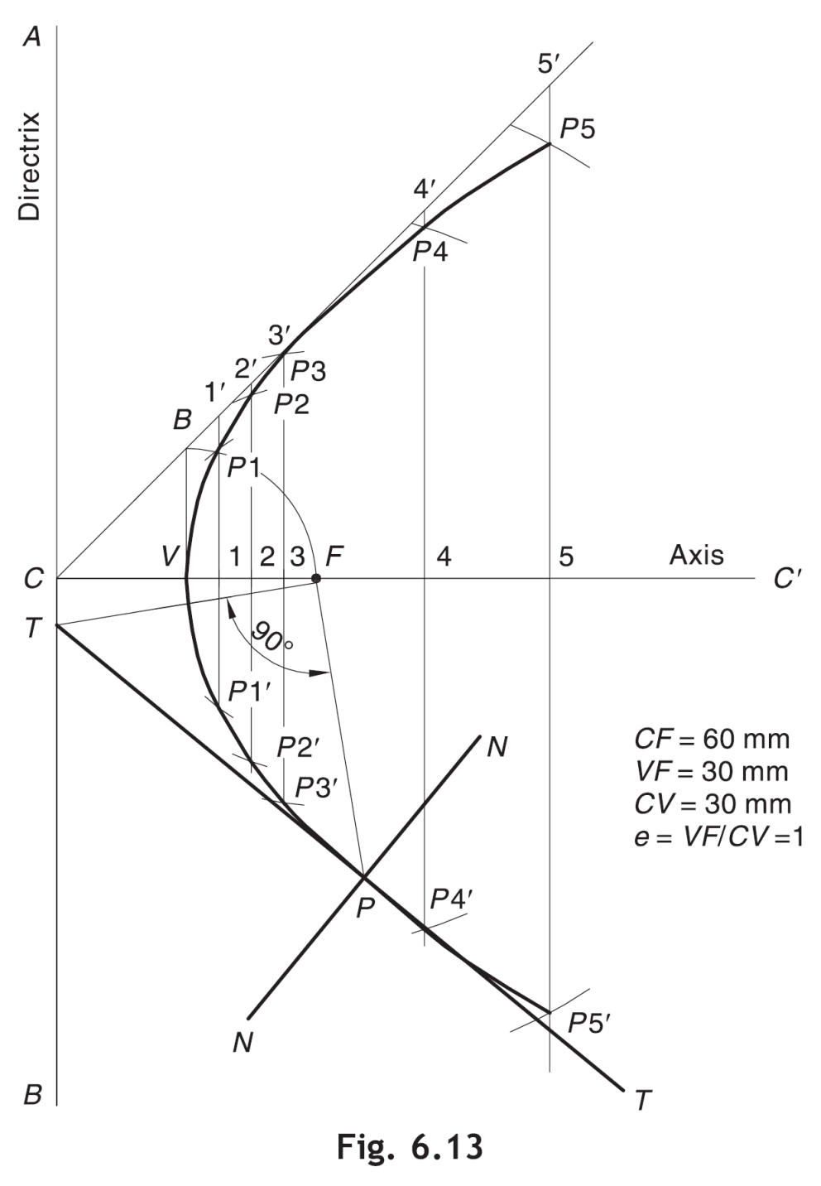
Parabola
A parabola is a conic whose eccentricity is equal to 1. It is an open-end curve with a focus, a directrix and an axis.
Any chord perpendicular to the axis is called a double ordinate.
The double ordinate passing through the focus represents the latus rectum
The double ordinate passing through the ends of the parabola, is called the base.
The shortest distance of the vertex from any ordinate, is known as the abscissa.

Slide 28
Methods for Generating Parabola
Focus-Directrix Or Eccentricity Method
General method of constructing any conics when the distance of the focus from the directrix is known and e = 1.
For example, draw a parabola if the distance of the focus from the directrix is 55 mm.
Rectangle Method and Parallelogram Method
This method is applicable when the axis (or abscissa) and the base (or double ordinate) of a parabola are given or the conjugate axes with the angle between them is given
For example, draw a parabola having an abscissa of 30 mm and the double ordinate are 70 mm, or
Draw an parabola having conjugate axes of 60 mm and 40 mm long and inclined at 75º to each other.
Tangent Method
This method is applicable when the base and the inclination of tangents at open ends of the parabola with the base are given
For example, draw a parabola if the base is 70 mm and the tangents at the base ends make 60° to the base.

Slide 29
14 September 2019
CE101 Lec2: Conics and Curves
29
Focus-Directrix or Eccentricity Method
A
Draw a parabola if the distance of the focus from the directrix is 60 mm.
5'
P5
Directrix
4'
Draw directrix AB and axis CC' as shown.
Mark F on CC' such that CF = 60 mm.
Mark V at the midpoint of CF. Therefore, e = VF/ VC = 1.
At V, erect a perpendicular VB = VF. Join CB.
Mark a few points, say, 1, 2, 3, … on VC’ and erect perpendiculars through them meeting CB produced at 1', 2', 3', …
With F as a centre and radius = 1–1', cut two arcs on the perpendicular through 1 to locate P1 and P1'. Similarly, with F as a centre and radii = 2–2', 3–3', etc., cut arcs on the corresponding perpendiculars to locate P2 and P2', P3 and P3', etc.
Draw a smooth curve passing through V, P1, P2, P3 … P3
P4
2'
3'
P3
1'
P2
B
P1
C
V
1
2
3
F
4
5
Axis
C"
P1'
P2'
P3'
P4'
P5'
B
Notes:
Here, the method is same as that of the ellipse.
Diff: Here we don’t draw that 45 degree line from F, bcoz that’s used to obtain other vertex of ellipse which is absent in a parabola.

Slide 30
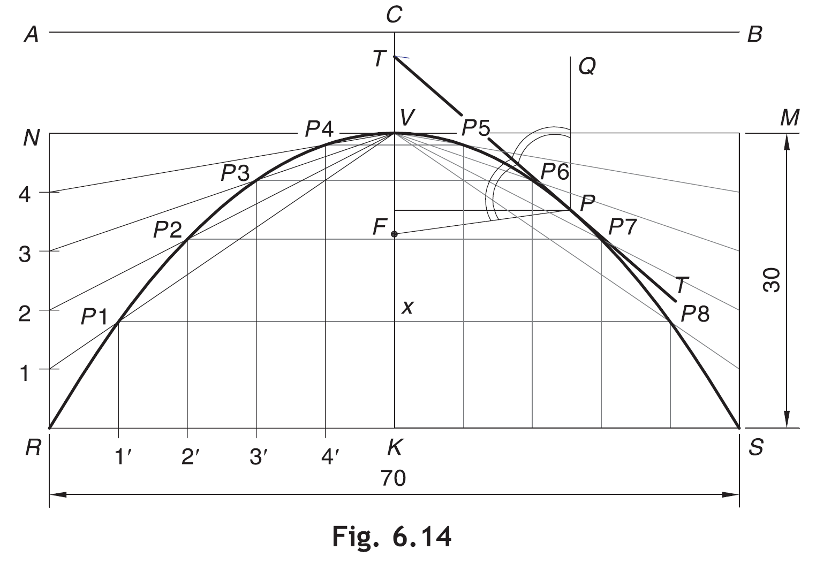
14 September 2019
CE101 Lec2: Conics and Curves
30
Rectangle Method
Draw a parabola having an abscissa of 30 mm and the double ordinate of 70 mm.
Draw the double ordinate RS = 70 mm. At midpoint K erect a perpendicular KV = 30 mm to represent the abscissa.
Construct a rectangle RSMN such that SM = KV.
Divide RN and RK into the same number of equal parts, say 5. Number the divisions as 1, 2, 3, 4 and 1', 2', 3', 4', starting from R.
Join V–1, V–2, V–3 and V–4.
Through 1', 2', 3' and 4', draw lines parallel to KV to meet V–1 at P1, V–2 at P2, V–3 at P3 and V–4 at P4, respectively
Obtain P5, P6, P7 and P8 in the other half of the rectangle in a similar way. Alternatively, these points can be obtained by drawing lines parallel to RS through P1, P2, P3 and P4. For example, draw P1– P8 such that P1– x = x– P8.
Join P1, P2, P3 … P8 to obtain the parabola
Notes:
Remembering trick:
Remember only the method of ellipse and use some logic.
Here, it can be thought that the other end of the minor axis V’ is going to infinity downwards.
Therefore , V’1’ is perpendicular to RS.
And then we obtain the intersection points similar to that of the ellipse

Slide 31
14 September 2019
CE101 Lec2: Conics and Curves
31
Construction by Rectangle Method
6
6
5
5
4
4
3
3
2
2
1
1
1
2
3
4
5
6
5
4
3
2
1

Slide 32
Tangent and Normal at a point P on parabola
Join PF
Draw PQ parallel to the axis.
Draw the bisector T– T of – FPQ to represent the required tangent.
Draw normal N– N perpendicular T– T at P.
Notes:
Mirror property of parabola is used

Slide 33
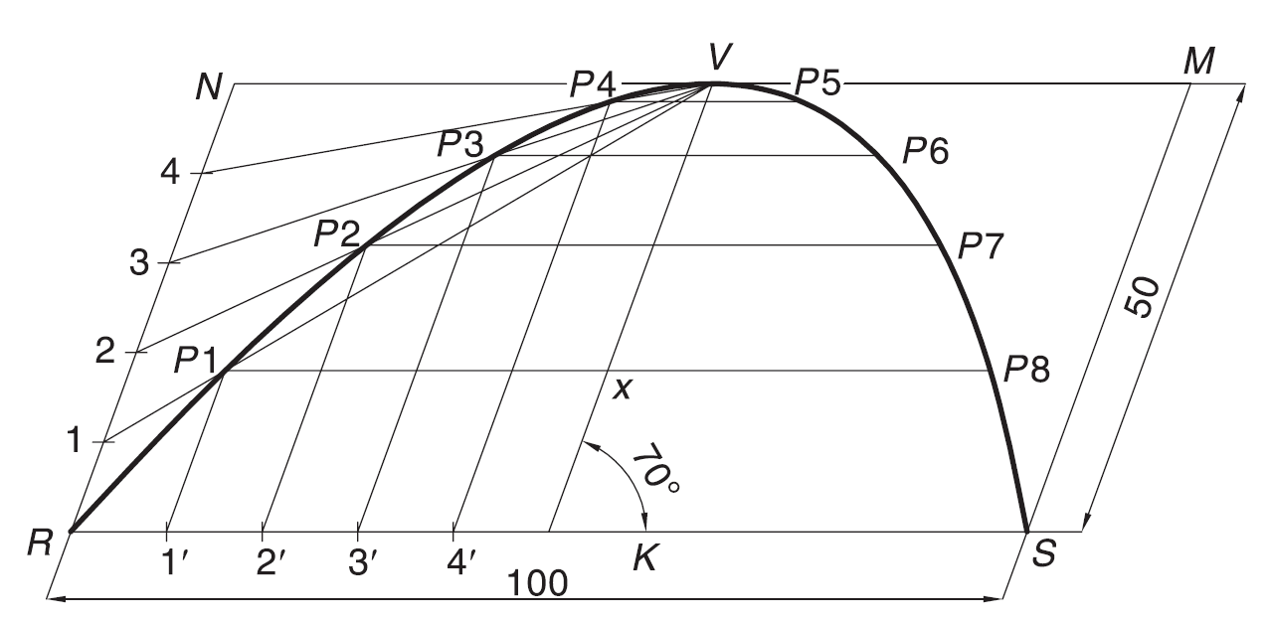
Parallelogram Method
Draw a parabola of base 100 mm and axis 50 mm if the axis makes 70° to the base.
Draw the base RS = 100 mm and through its midpoint K, draw the axis KV = 50 mm, inclined at 70° to RS.
Draw a parallelogram RSMN such that SM is parallel and equal to KV.
Follow steps as in rectangle method

Slide 34
14 September 2019
CE101 Lec2: Conics and Curves
34
Tangent Method
Draw a parabola if the base is 70 mm and the tangents at the base ends make 60° to the base.
L
Draw the base RS = 70 mm. Through R and S, draw the lines at 60° to the base, meeting at L.
Divide RL and SL into the same number of equal parts, say 6. Number the divisions as 1, 2, 3 … and 1', 2', 3', … as shown.
Join 1–1', 2–2', 3–3', ….
Draw a smooth curve, starting from R and ending at S and tangent to 1–1', 2–2', 3–3', etc., at P1, P2, P3, etc., respectively
5
1'
4
2'
3
3'
2
4'
1
5'
R
S
K

Slide 35
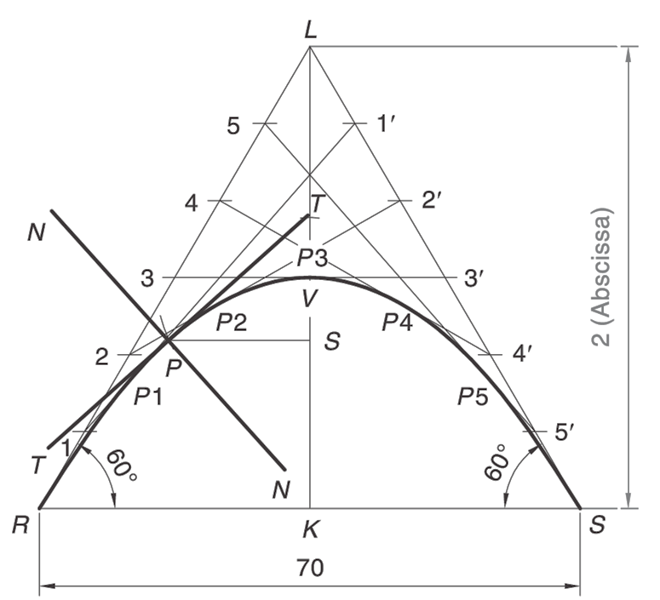
14 September 2019
CE101 Lec2: Conics and Curves
35
Tangent Method
Method to draw a tangent and normal at a point on the parabola created by Tangent method
Locate the point P on the curve.
Draw the ordinate PS.
On LK, mark T such that TV =VS.
Join TP and extend to obtain tangent TT
Draw normal N-N perpendicular to T-T at P

Slide 36
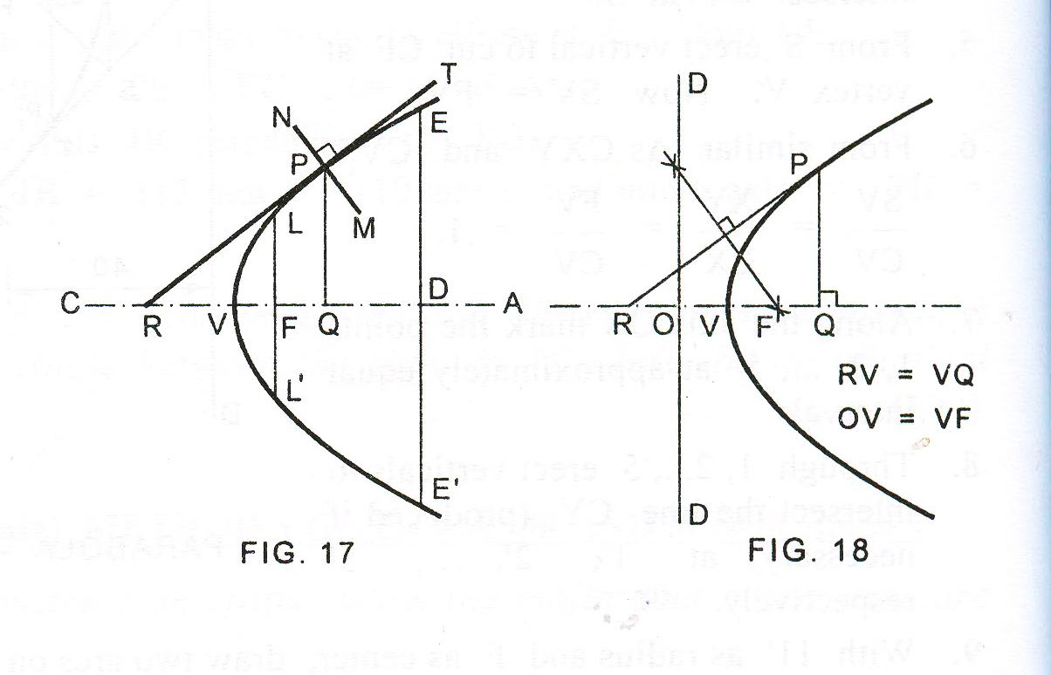
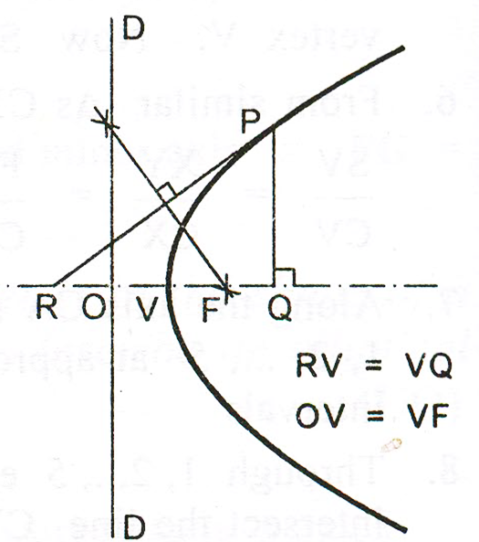
14 September 2019
CE101 Lec2: Conics and Curves
36
Unknown Focus and Directrix
Tangent and Normal at any point P when Focus and Directrix are not known
Draw the ordinate PQ
Find the abscissa VQ
Mark R on CA such that RV=VQ
Draw the normal NM perpendicular to RP at P
To find the focus and the directrix of a parabola given its axis
Mark any point P on the parabola
Draw a perpendicular PQ to the given axis
Mark a point R on the axis such that RV=VQ
Focus: Join RP. Draw a perpendicular bisector of RP cutting the axis at F, F is the focus
Directrix: Mark O on the axis such that OV = VF. Through O draw the directrix DD perpendicular to the axis

Slide 37
Hyperbola
Notes:
Today we will discuss about the Modeling and

Slide 38
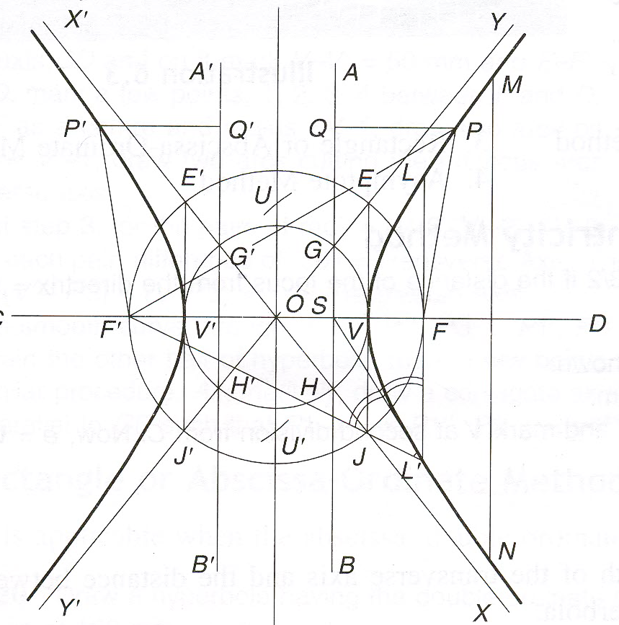
Hyperbola e>1
The hyperbola is an open-end curve and exist in a pair. It has two foci (F and F′), two directrices (AB and A′B′), an axis and two vertices (V and V′)
Transverse axis or Major axis : Line joining two vertices.
Conjugate axis: Line perpendicular to transverse axis at centre of hyperbola (O)
Double ordinate (MN): Any chord, Say MN, perpendicular to the axis
Abscissa: Distance of the nearest vertex from the given ordinate.
Asymptotes: The two lines X-X′ and Y-Y′ intersecting at O
Directrix (GH and G′H′): O as centre and OV and OV′ as radius, draw arcs to cut the asymptotes.
Draw a circle with O as centre and radius OF. Draw perpendicular to (V, V′) at V and V′ cutting the circle at E, J and E′, J ′. The diagonals E, J′ and E′, J are the asymptotes
Notes:
If it is not specified anything in the question about the no. of branches to draw, then draw both of them

Slide 39
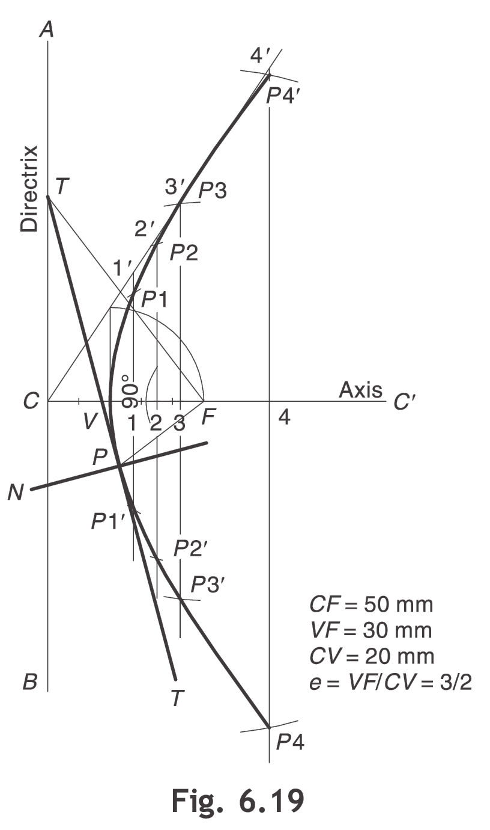
Focus-Directrix or Eccentricity Method
Draw a hyperbola of e = 3/2 if the distance of the focus from the directrix = 50 mm.
Draw directrix AB and axis CC' as shown.
Mark F on CC' such that CF = 50 mm.
Divide CF in to 3 + 2 = 5 equal parts and mark V at second division from C.
Now, e = VF/ VC = 3/2.
Follow steps as in ellipse and parabola

Slide 40
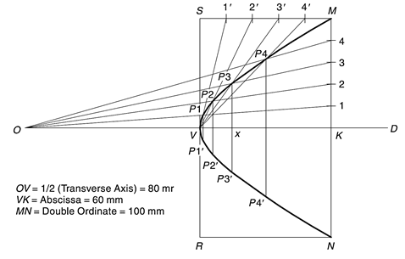
14 September 2019
CE101 Lec2: Conics and Curves
40
Rectangle or Abscissa-Ordinate Method
Draw a hyperbola having the double ordinate of 100 mm, the abscissa of 60 mm and the transverse axis of 160 m
Draw axis OD and mark V and K on it such that OV = 1/2(Transverse Axis) = 80 mm and VK =Abscissa = 60 mm.
Through K, draw double ordinate MN = 100 mm.
Construct rectangle MNRS such that NR = VK.
Divide MK and MS into the same number of equal parts, say 5. Number the divisions as shown.
Join O–1, O–2, O–3, etc. Also join V–1', V–2', V–3', etc.
Mark P1, P2, P3, etc., at the intersections of O–1 and V–1', O–2 and V–2', O–3 and V–3', etc., respectively.
Similarly obtain P1', P2', P3', etc., for other half. Alternatively, draw P1/P1', P2/P2', P3/P3', etc., such that P3–x = x–P3' and likewise.
Join all such points to obtain the hyperbola

Slide 41
Involutes and Cycloids
Notes:
Today we will discuss about the Modeling and

Slide 42
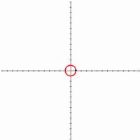

Engineering Curves
Roulettes
Roulettes are curves generated by the rolling contact of one curve or line on another curve or line
Various types of Roulettes
Involutes and Cycloids

Slide 43
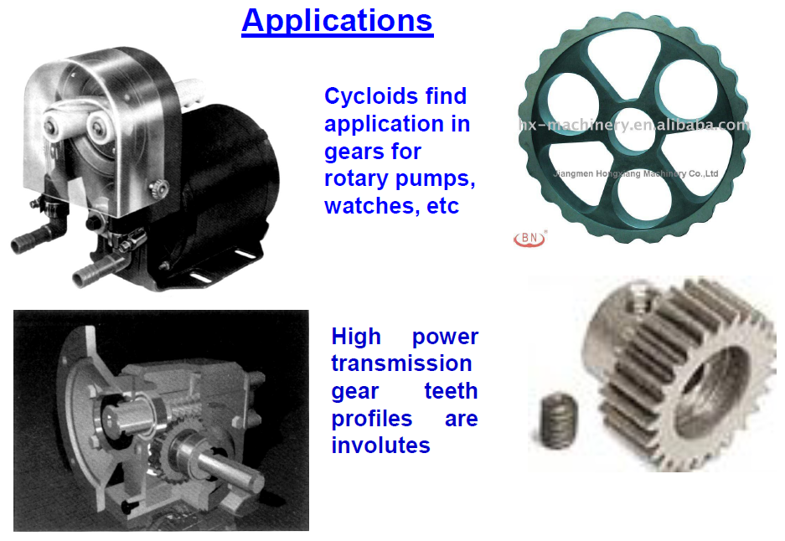
14 September 2019
CE101 Lec2: Conics and Curves
43

Slide 44
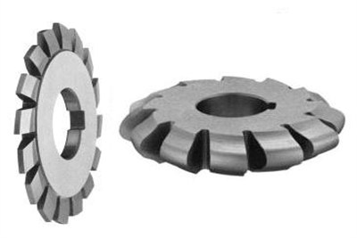
Involutes
An involute is a curve traced by the free end of a thread unwound from a circle or a polygon, in such a way that the thread is always tight and tangential to the circle or follows the sides of the polygon.
Depending on whether the involute is traced over a circle or a polygon, the involute is called an involute of circle or involute of polygon
Involute gear

Slide 45
Involute of a Circle
Draw the involute of a circle, 40 mm in diameter. Also draw the tangent and normal at a point on the curve at a distance of 100 mm from the centre of the circle.
Point P at the end of the string AP is exactly at a distance of πD away from A. Means, if this string is wound round the circle, it will completely cover given circle. P will meet A after winding.
Divide the circle into 8 parts
Divide πD distance (AP) into 8 number of equal parts
Name after A, 1, 2, 3, 4, etc. up to 8 on πD line AP as well as on circle (anticlockwise direction).
4
3
5
2
6
C
7
1
A
8
P
1 2
3 4
5 6
7 8
πD

Slide 46
Involute of a Circle
Draw the involute of a circle, 40 mm in diameter. Also draw the tangent and normal at a point on the curve at a distance of 100 mm from the centre of the circle.
P₂
Draw tangents from the points marked on the circle (1, 2, … 8)
Length of tangent at Point 1 = 1-P on line AP
Length of tangent at Point 2 = 2-P on line AP
Similarly, assess the length of other tangents
Mark and name the points as P1, P2, …, P8
Join the obtained points to develop a smooth involute
P₃
P₁
2-P
3-P
1-P
P₄
4-P
4
3
5
2
5-P
6
C
7
1
6-P
A
8
P
P₅
7-P
P₈
1 2
3 4
5 6
7 8
P₇
P₆
πD

Slide 47
Involute of a Circle
Tangent and Normal to the involute of a circle
P₂
Normal
Mark point Q on involute
Join Q to the center of circle C
Considering CQ as diameter, draw a semicircle as shown
Mark the point of intersection of this semicircle and pole circle and join it to Q
This will be normal to involute
Draw a line at right angle to this line from Q to get tangent to the involute
Q
P₃
Tangent
2-P
P₁
3-P
1-P
P₄
4-P
4
3
5
2
5-P
6
C
7
1
6-P
A
8
P
P₅
7-P
P₈
1 2
3 4
5 6
7 8
P₇
P₆
πD

Slide 48
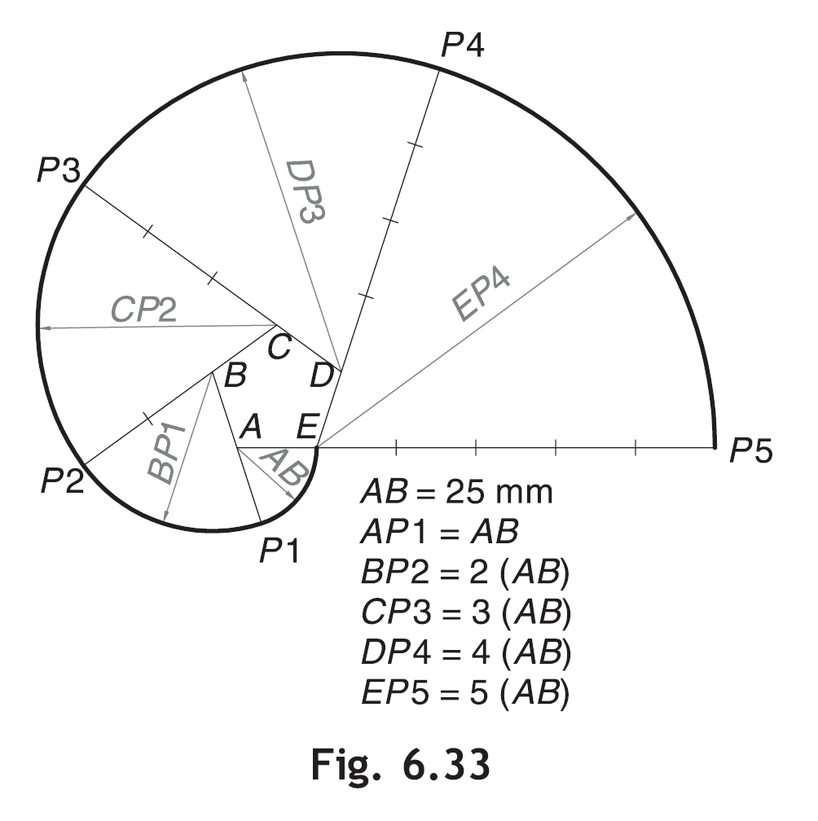
Involute of a Pentagon
Draw the involute of a regular pentagon of 25 mm side

Slide 49
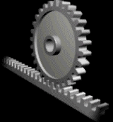
CYCLOID
A Cycloid is generated by a point on the circumference of a circle rolling along a straight line, without being slipped
The rolling circle is called a generating circle and the straight line is called a directing line or base line.
The point on the generating circle which traces the curve is called the generating point.

Slide 50
Cycloid, Epicycloid and Hypocycloid
Cycloid – Circle rolling over a straight line
Epicycloid – Circle rolling outside another circle
Hypocycloid – Circle rolling inside another circle

Slide 51
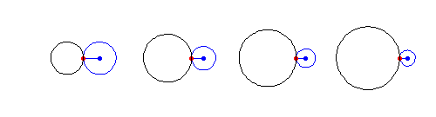
Cycloid, Epicycloid and Hypocycloid
Cycloid – Circle rolling over a straight line
Epicycloid – Circle rolling outside another circle
Hypocycloid – Circle rolling inside another circle

Slide 52
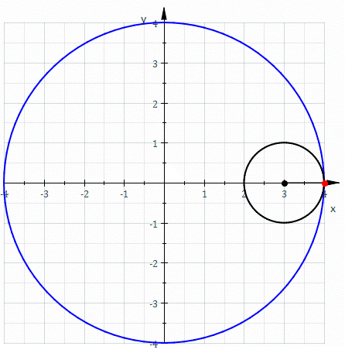
Cycloid, Epicycloid and Hypocycloid
Cycloid – Circle rolling over a straight line
Epicycloid – Circle rolling outside another circle
Hypocycloid – Circle rolling inside another circle

Slide 53
Construction of Cycloid
A wheel of diameter 60 cm rolls on a straight horizontal road. Draw the locus of a point P on the periphery of the wheel, for one revolution of the wheel, if P is initially on the road
Draw the base line P'–P" equal to the circumference of generating circle, i.e., π x 60 cm = 188 cm
Draw the generating circle with C as centre and radius = 30 cm, tangent to P'-P" at P'. Point P is initially at P'
C
P′
P"

Slide 54
Construction of Cycloid
A wheel of diameter 60 cm rolls on a straight horizontal road. Draw the locus of a point P on the periphery of the wheel, for one revolution of the wheel, if P is initially on the road
Draw C–C" parallel and equal to P'–P" to represent the locus of the centre of the generating circle
Obtain 12 equal divisions on the circle. Number the intersecting points as 1, 2, 3, etc., starting from P' as shown.
Through 1, 2, 3, etc., draw lines parallel to P'–P".
6
5
7
4
8
C
9
C"
3
2
10
1
11
P′
P"

Slide 55
Construction of Cycloid
A wheel of diameter 60 cm rolls on a straight horizontal road. Draw the locus of a point P on the periphery of the wheel, for one revolution of the wheel, if P is initially on the road
Obtain 12 equal divisions on C–C" and name them as C1, C2, C3, etc.
With C1, as the centre and radius = CP' = 30 mm, cut an arc on the line through 1, to locate the point P1.
With C2, as the centre and radius = CP' = 30 mm, cut an arc on the line through 1, to locate the point P2.
6
5
7
4
8
C
9
C"
3
C1
C2
C3
C4
C5
C6
C7
C8
C9
C10
C11
C12
P2
2
10
P1
1
11
P′
P"

Slide 56
Construction of Cycloid
A wheel of diameter 60 cm rolls on a straight horizontal road. Draw the locus of a point P on the periphery of the wheel, for one revolution of the wheel, if P is initially on the road
Repeat the process for other centre points and obtain the points P3 – P12.
Join P', P1, P2, P3, etc. by a smooth curve to create the cycloid
6
P6
5
7
P5
P7
4
8
P4
P8
P3
9
P9
3
C
C"
C1
C2
C3
C4
C5
C6
C7
C8
C9
C10
C11
C12
P2
P10
2
10
P1
P11
1
11
P′
P"

Slide 57
Construction of Cycloid
Tangent and Normal to the Cycloid
Mark point Q as given.
From Q, cut the point on locus of C (C-C12) as R with radius RQ = CP'.
From this point R, drop a perpendicular on ground line P'-P" and name it as N
Join N with Q. This will be normal to cycloid.
Draw a line at right angle to normal to get tangent to cycloid.
Normal
6
P6
5
7
P5
Q
P4
P7
Tangent
4
8
R
P8
P3
9
P9
3
C
C"
C1
C2
C3
C4
C5
C6
C7
C8
C9
C10
C11
C12
P2
P10
2
10
P1
P11
1
11
P′
N
P"

Slide 58
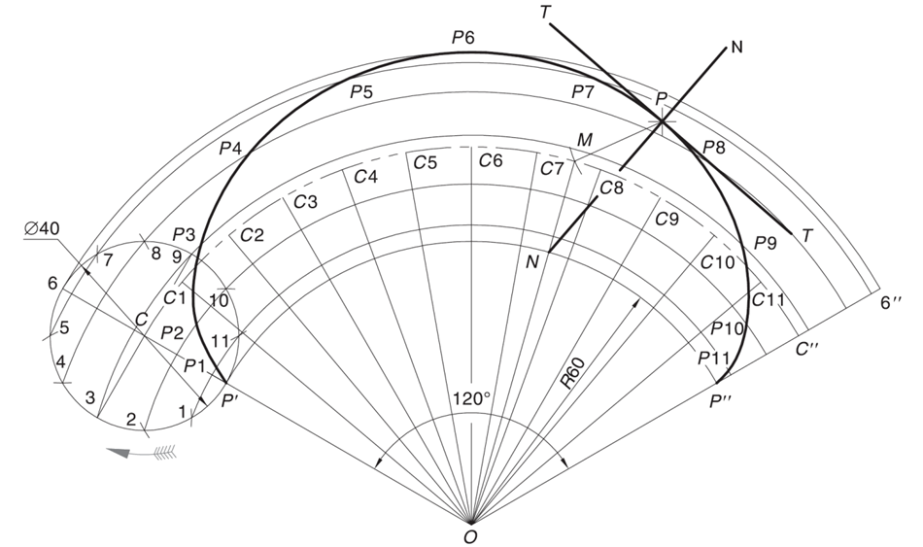
Construction of Epicycloid
Draw an epicycloid if a circle of 40 mm diameter rolls outside another circle of diameter 120 mm for one revolution
Calculate the subtended angle for a full revolution: θ = (r / R) x 360° = (20/60) x 360° = 120°
With O as a centre and radius = 60 mm, draw the directing arc P'–P", which gives included angle 120°.
Produce OP' and locate C on it such that CP' = radius of generating circle = 20 mm. With C as centre and radius = CP', draw a circle.
With O as a centre and radius = OC, draw an arc C–C" such that ∠COC" = 120°. Arc C–C" represents the locus of centre of generating circle.
Divide the circle into 12 equal parts. With O as a centre and radii = O–1, O–2, O–3, etc., draw the arcs through 1, 2, 3, etc., parallel to arc P'–P".
Remaining steps are same as that for cycloid discussed before.

Slide 59
Construction of Epicycloid
Draw an epicycloid if a circle of 40 mm diameter rolls outside another circle of diameter 120 mm for one revolution
Generating/
Rolling Circle
4
5
C₁
C₂
C₃
C₄
3
C
6
C₅
7
C₆
2
r = CP
1
P
C₇
Directing Circle
R
C₈
r
+
=
360⁰
P'
R
O

Slide 60
Tangent and Normal on Epicycloid
Tangent and Normal to the Epicycloid
Mark point Q as given.
From Q, cut the point on locus of C (C-C12) as R with radius RQ = CP'.
From this point R, join the centre of the circle O. The line cuts the directing circle at N
Join N with Q. This will be normal to epicycloid.
Draw a line at right angle to normal to get tangent to epicycloid.
Normal
Generating/
Rolling Circle
Q
4
5
Tangent
C₁
C₂
C₃
R
6
C₄
3
C
C₅
7
N
C₆
2
r = CP
1
P
C₇
Directing Circle
R
C₈
r
+
=
360⁰
P'
R
O

Slide 61
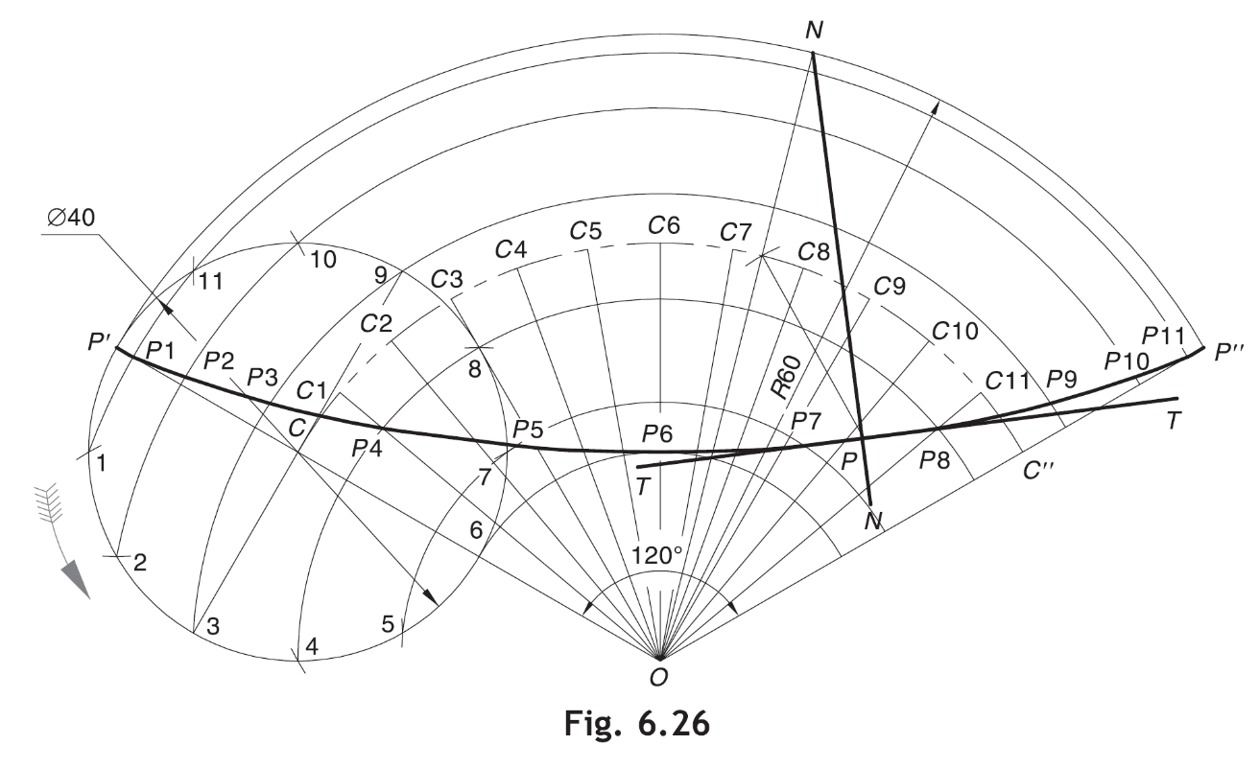
Construction of Hypocycloid
A circle of diameter 40 mm rolls inside another circle of radius 60 mm. Draw the hypocycloid traced by a point on the rolling circle initially in contact with the directing circle for one revolution
Calculate the subtended angle: θ = (r / R) x 360° = (20/60) x 360° = 120°
With O as a centre and radius = 60 mm, draw the directing arc P'–P", which gives included angle 120°.
Produce OP' and locate C on it such that CP' = radius of generating circle = 20 mm. With C as centre and radius = CP', draw a circle.
Remaining steps are same as that for epicycloid discussed before.

Slide 62
Construction of Hypocycloid
8
9
10
7
11
6
12
5
4
c₈
c₉
c₁₀
c₇
c₁₁
c₁₂
3
c₆
c₅
c₄
2
2’
3’
c₃
4’
c₂
1
1’
c₁
5’
θ
12’
P
C
6’
O
11’
7’
10’
9’
8’
OP = Radius of directing circle = 60 mm
PC = Radius of generating circle = 20 mm
θ = r/R x 360º = 20/60 x 360° = 120°
Notes:
Draw the labels on the rollimg circle starting from the directing axis(circumference of big circle)

Slide 63
Tangent and Normal on Hypocycloid
N
8
9
10
7
11
6
12
Tangent
5
R
4
c₈
c₉
c₁₀
Q
c₇
c₁₁
c₁₂
3
c₆
c₅
c₄
Normal
2
2’
3’
c₃
4’
c₂
1
1’
c₁
5’
θ
12’
P
C
6’
O
11’
7’
10’
9’
8’
OP = Radius of directing circle = 60 mm
PC = Radius of generating circle = 20 mm
θ = r/R x 360º = 20/60 x 360° = 120°
Notes:
In epicycloid as well as hypocycloid , divide both the circles into the same number of equal parts

Slide 64

Thank You for Patient Hearing

